Slide 1

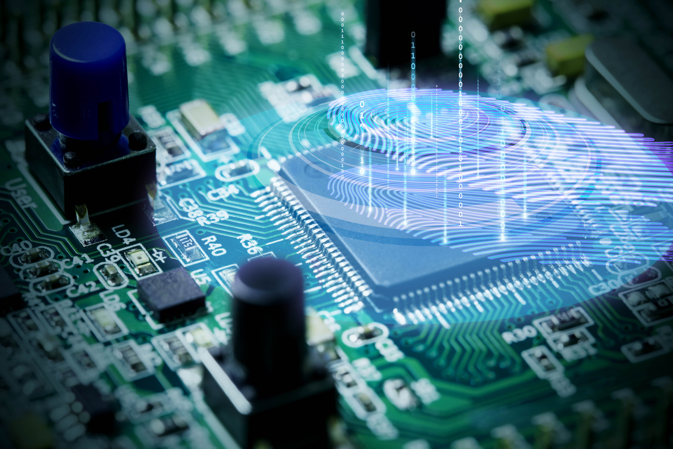




Mini Project I Proposal
Daniah Muti, WD73 – TechBlazers.

Slide 2






Table of Contents
Website Name
Who is this website for?
What to expect, find & do on this website?
Sample of similar websites
What will be the pages/sections of our website?
Wireframe (desktop & mobile view)

Slide 3




Introduction
Welcome to Lantern Institute and Engineering Services, a leading provider of comprehensive training, consultancy, and engineering solutions. With our diverse range of services, we aim to equip individuals and organizations with the skills, expertise, and support they need to excel in the fields of technology, engineering, and product development. Whether you are a student, a professional, or a business looking to enhance your capabilities, we have tailored offerings to meet your specific requirements.

Slide 4

Website Name
The history and how this company was formed.

Slide 5

History:
Our company was officially formed around 2018, all started by a passionate electronics and communication engineer student from Anna University in Chennai, India.
His name is Engr. Faizan Ul Haq. He’s been making project commissions and creating workshops (as requested by his university) due to his advanced expertise in the field, even as a student.
Because of this, his small business was formed, and decided to name it “Lantern Institute & Engineering Services”.

Slide 6



Why “Lantern”?
Just like a lantern, we needed a light to guide us through the dark moments.
Especially in technology, which is inevitably a complex field one could comprehend.
Hence with guidance from our passionate experts, we’ll guide you through as much as you can.

Slide 7



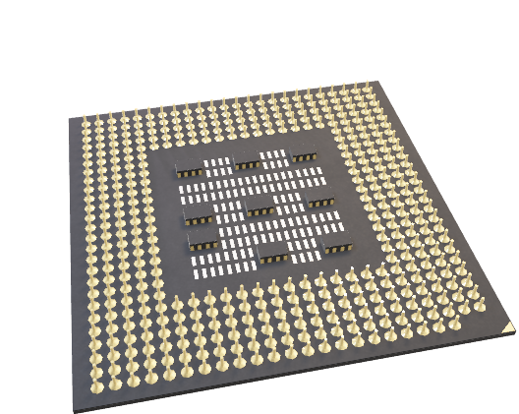

Timeline:
Yes, he’s a student teaching other fellow students too.
Commission for big sister’s classmates.
Noticed by the university for its academic excellence & advanced expertise out of passion.
2019
Requested to do workshops by university & taking commissions personally.
2020
present
Has been running for almost 4-5 years.
Have decided to form a team, along with other passionate individuals, & first logo was made
2017
2018

Slide 8


Evolution of Logo:
Year: 2022
Year: 2020
Year: 2023

Slide 9
Who is this site for?
And why?

Slide 10

For the students & project developers.
Aspiring engineering students.
Those who want to let their product ideas come to life.
Needed a hand in technology.

Slide 11
What to expect, find & do on this website?
Why does it need to exist?

Slide 12
What to expect?
There have been a lot of technology-related services which, based on our research, have only catered to employed individuals.
Our website will represent our small-time company, especially to students and small-time business owners who want their ideas to come to life at a more affordable rate.
Expectations: the website will advertise what we do, and what our services will be only. Contact details will be provided for ANY additional info (e.g., blogs and social media accounts).
Again, this is strictly an advertisement website. No rates will be mentioned as it’s negotiable & needed to be discussed personally via existing social media accounts (provided on the website, as well).

Slide 13



What to find?
PAGES:
HOME
ABOUT US
SERVICES
BLOGS (optional)
CONTACT US

Slide 14
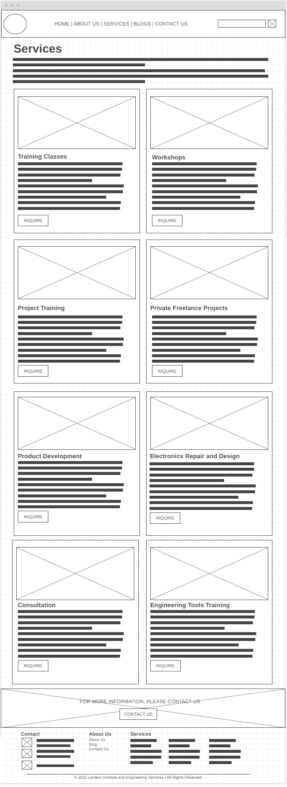
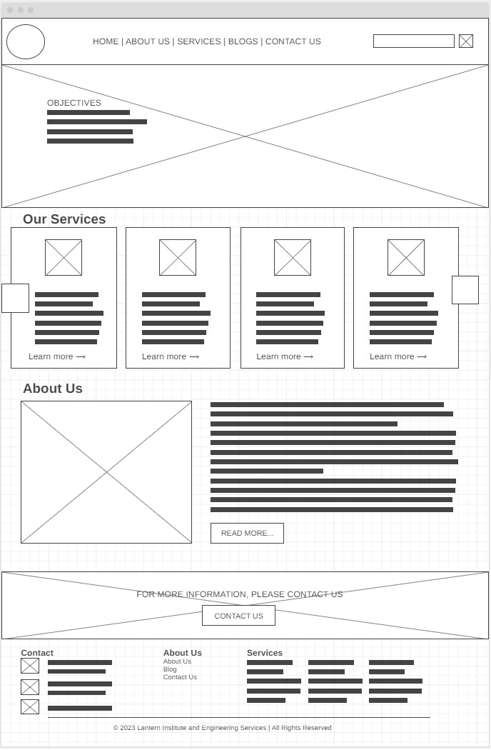
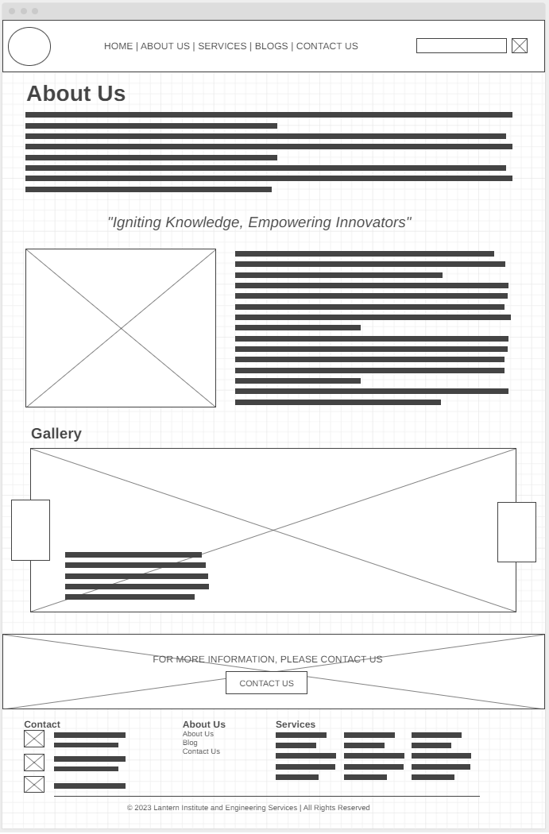
DESKTOP VIEW

Slide 15
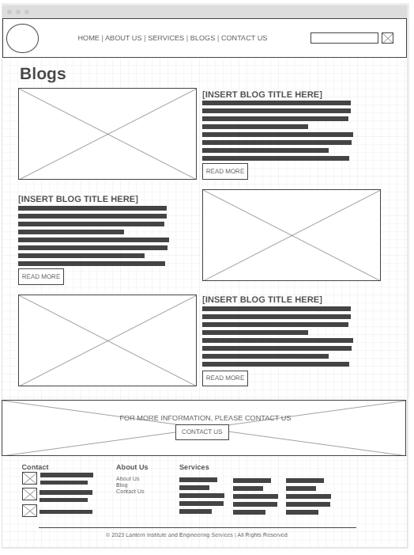
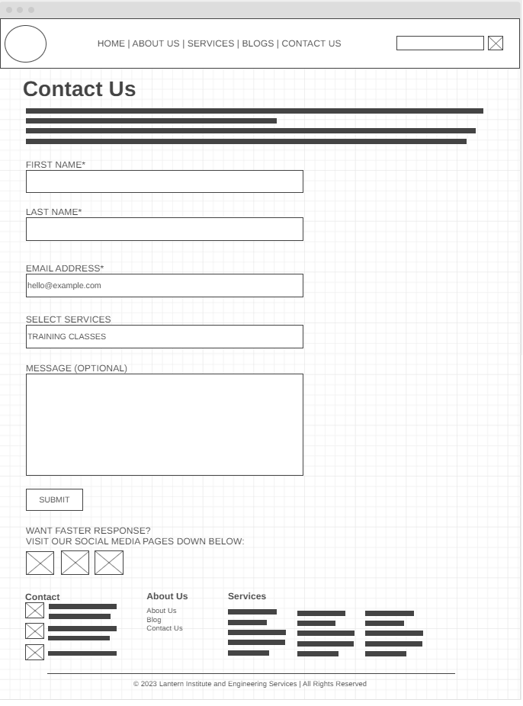
DESKTOP VIEW

Slide 16
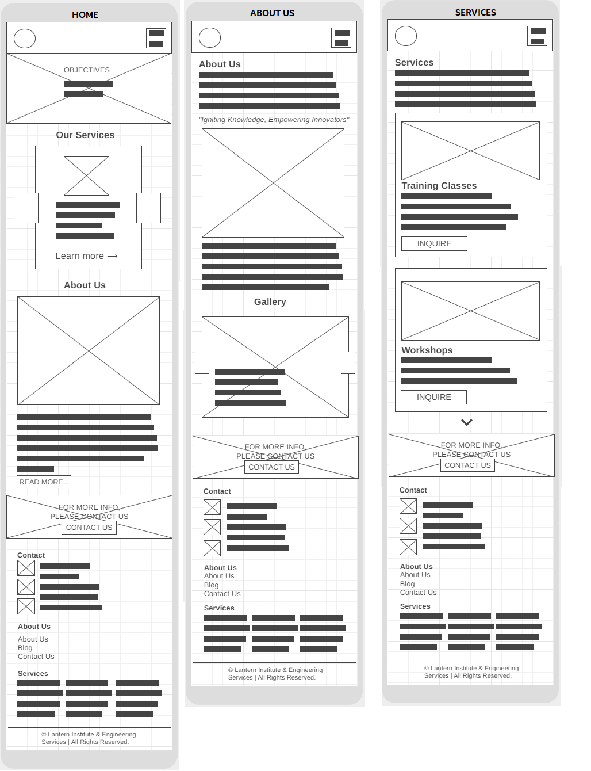
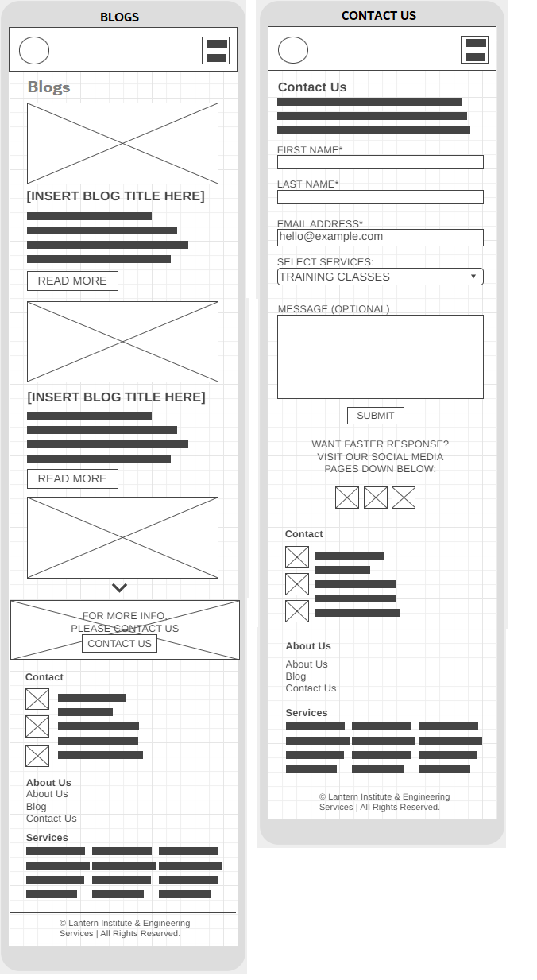

MOBILE VIEW

Slide 17
What to do?
Feel free to navigate or explore our website.
Check our services in detail.
Contact us via the social media accounts provided (for the sake of static website intention).

Slide 18
Sample of similar websites
The inspiration behind.

Slide 19
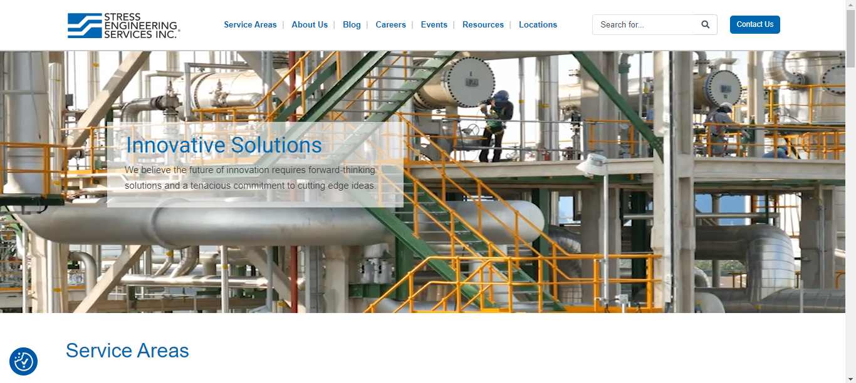
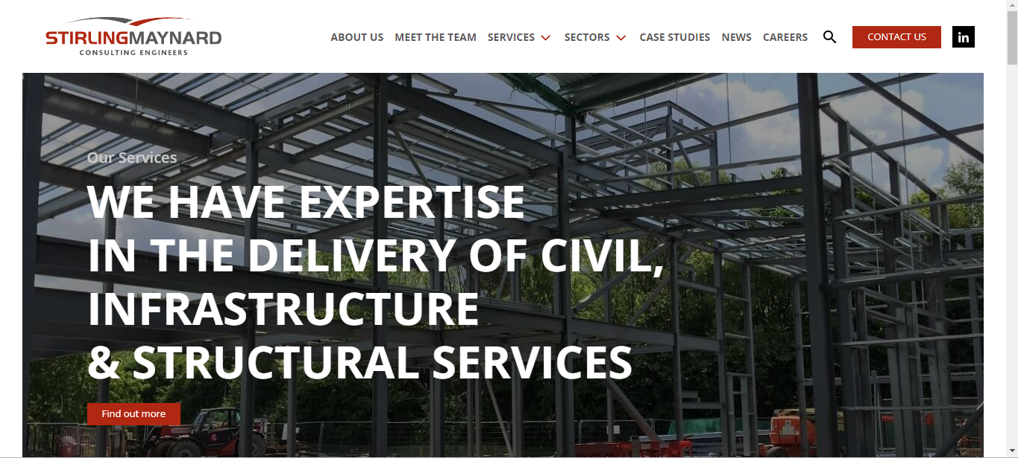
Inspiration(s):

Slide 20
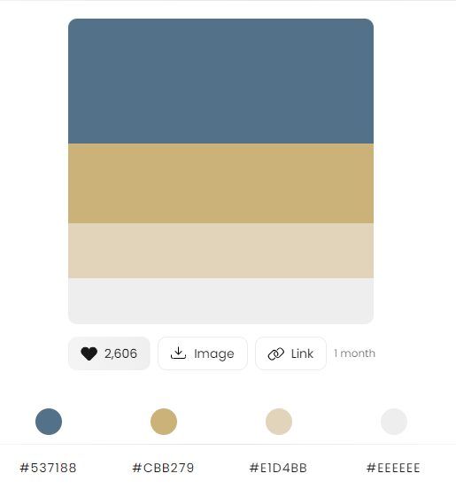
COLOR THEME:

Slide 21
What will be the pages/sections of our website?
Based on estimation…

Slide 22
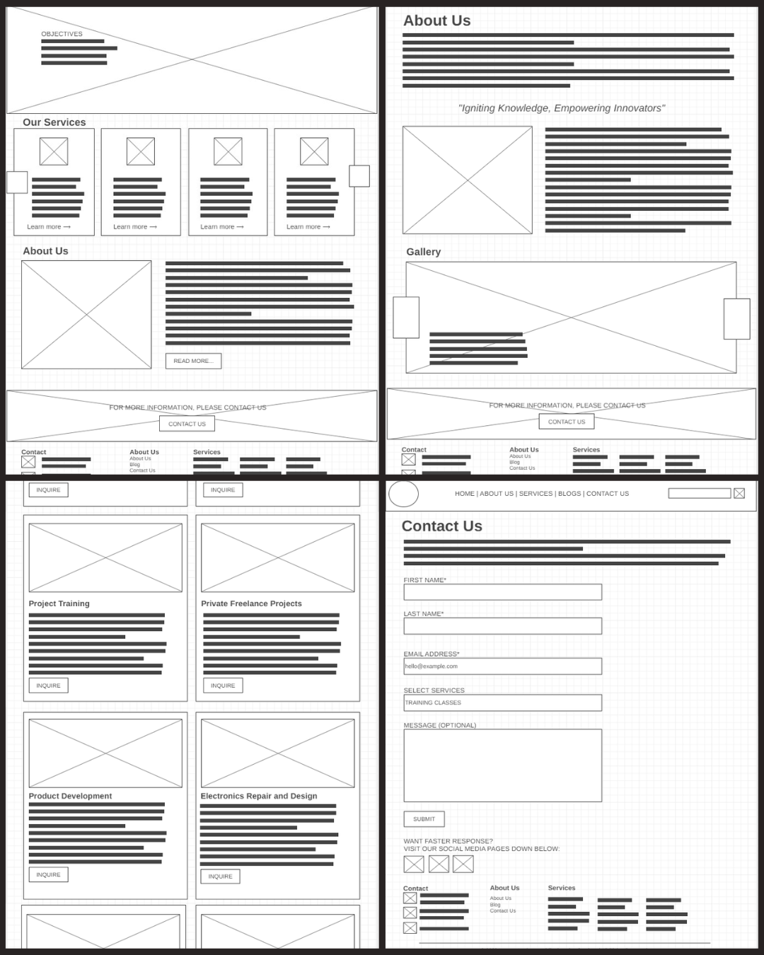
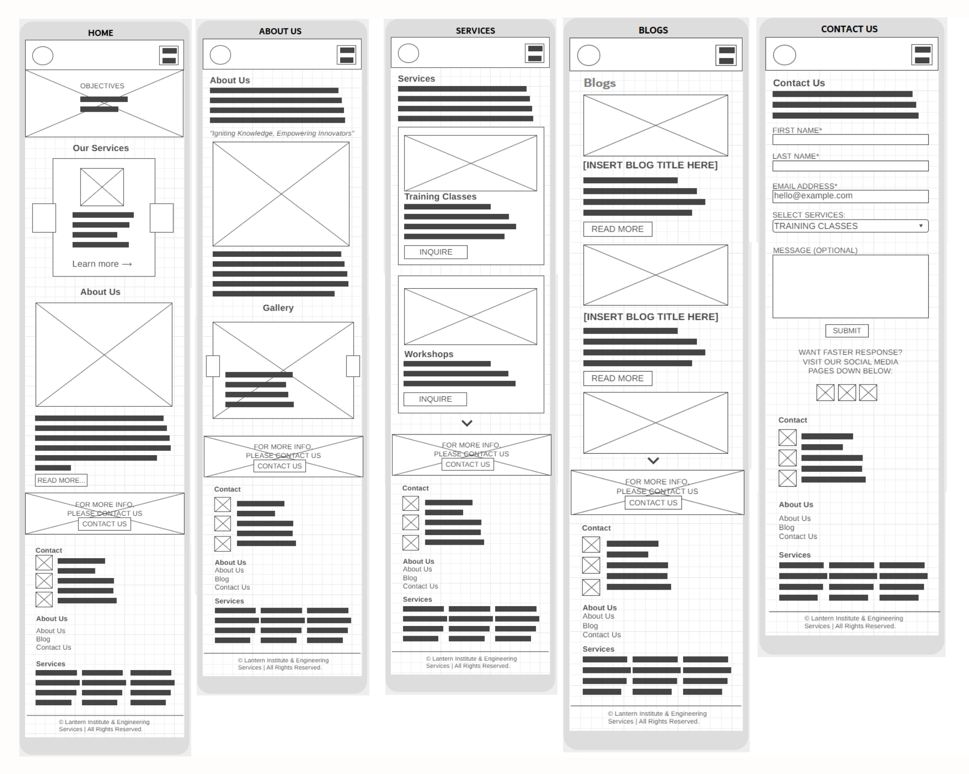
…A total of 4 to 5 pages.

Slide 23
Wireframe (desktop & mobile view).
A closer look.

Slide 24

An automatic sliding (or not) welcoming header, indicating the ‘Objectives’ of our company.
Header (Navigation Bar)
- Official Logo
- Menu:
- Home
- About Us
- Services
- Blogs (optional)
- Contact Us
- Search bar (optional)
HOME
ICON
ICON
ICON
ICON
DESCRIPTION
Our Services: with Font Awesome/Icons + Title & Description + ‘Learn more’ will lead to ‘SERVICES’ page.
DESCRIPTION
DESKTOP VIEW
Main
About Us: showing a glimpse of the ‘About Us’ page, with ‘READ MORE’ leading to the said page.
‘CONTACT US’ banner will lead to the ‘CONTACT US’ page.
Footer

Slide 25
About Us indicates history. This is the page after clicking “About Us” in Nav-Bar.
Header (Navigation Bar)
- Official Logo
- Menu:
- Home
- About Us
- Services
- Blogs (optional)
- Contact Us
- Search bar (optional)
ABOUT US
Picture is the evolution of logo of our company + details in description.
DESKTOP VIEW
Main
Gallery: showcasing all photos related to company’s journey.
‘CONTACT US’ banner will lead to the ‘CONTACT US’ page.
Footer

Slide 26
Services: summarizing all details, explaining our services and purposes.
Header (Navigation Bar)
- Official Logo
- Menu:
- Home
- About Us
- Services
- Blogs (optional)
- Contact Us
- Search bar (optional)
SERVICES
DESKTOP VIEW
Main
A total of 8 services, namely:
Training Classes
Workshops
Project Training
Private Freelance Projects
Product Development
Electronics Repair and Design
Consultation
Engineering Tools Training

Slide 27
SERVICES
Main
(continuation)
All “INQUIRE” buttons would lead to the “CONTACT US” page.
DESKTOP VIEW
‘CONTACT US’ banner will lead to the ‘CONTACT US’ page.
Footer

Slide 28
Header (Navigation Bar)
- Official Logo
- Menu:
- Home
- About Us
- Services
- Blogs (optional)
- Contact Us
- Search bar (optional)
BLOGS
Main
DESKTOP VIEW
BLOGS is optional as it requires PHP, meaning possible updates.
‘CONTACT US’ banner will lead to the ‘CONTACT US’ page.
Footer

Slide 29
Header (Navigation Bar)
- Official Logo
- Menu:
- Home
- About Us
- Services
- Blogs (optional)
- Contact Us
- Search bar (optional)
BLOGS
Main
DESKTOP VIEW
CONTACT US, as usual part of every advertising or services-related website.
HERE DISPLAY OFFICIAL SOCIAL MEDIA ACCOUNTS.
Footer

Slide 30
MOBILE VIEW

Slide 31

Summary
In conclusion, our website’s main aim is to advertise our team’s skills and what services we offer.
Catering to those students & project developers from small-time businesses.

Slide 32





Thank You!
Daniah Muti
KodeGo – Batch WD73, “TechBlazers”
daniahmuti@gmail.com

